Slide 1
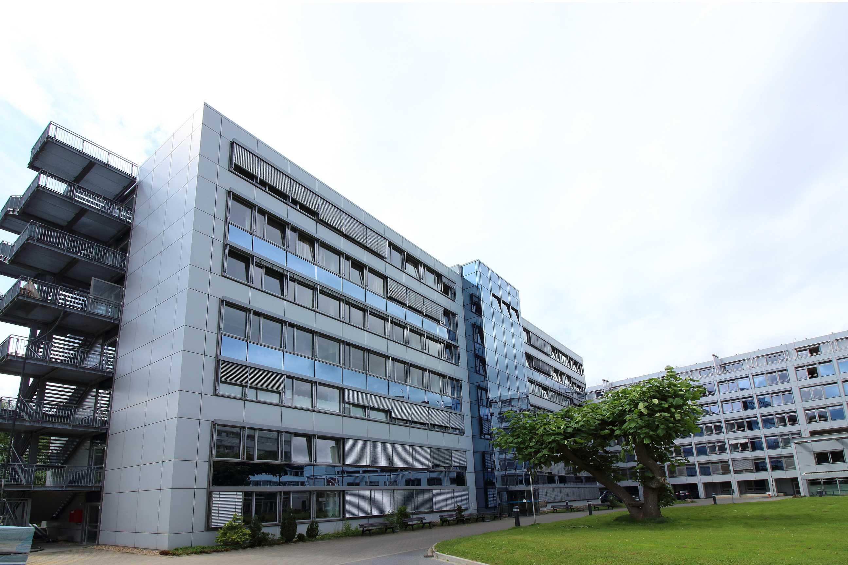
Rapid Care
An application dedicated to efficiently delivering essential resources to hospitals in urgent situations, prioritizing speed and effectiveness.
Team PRM

Slide 2
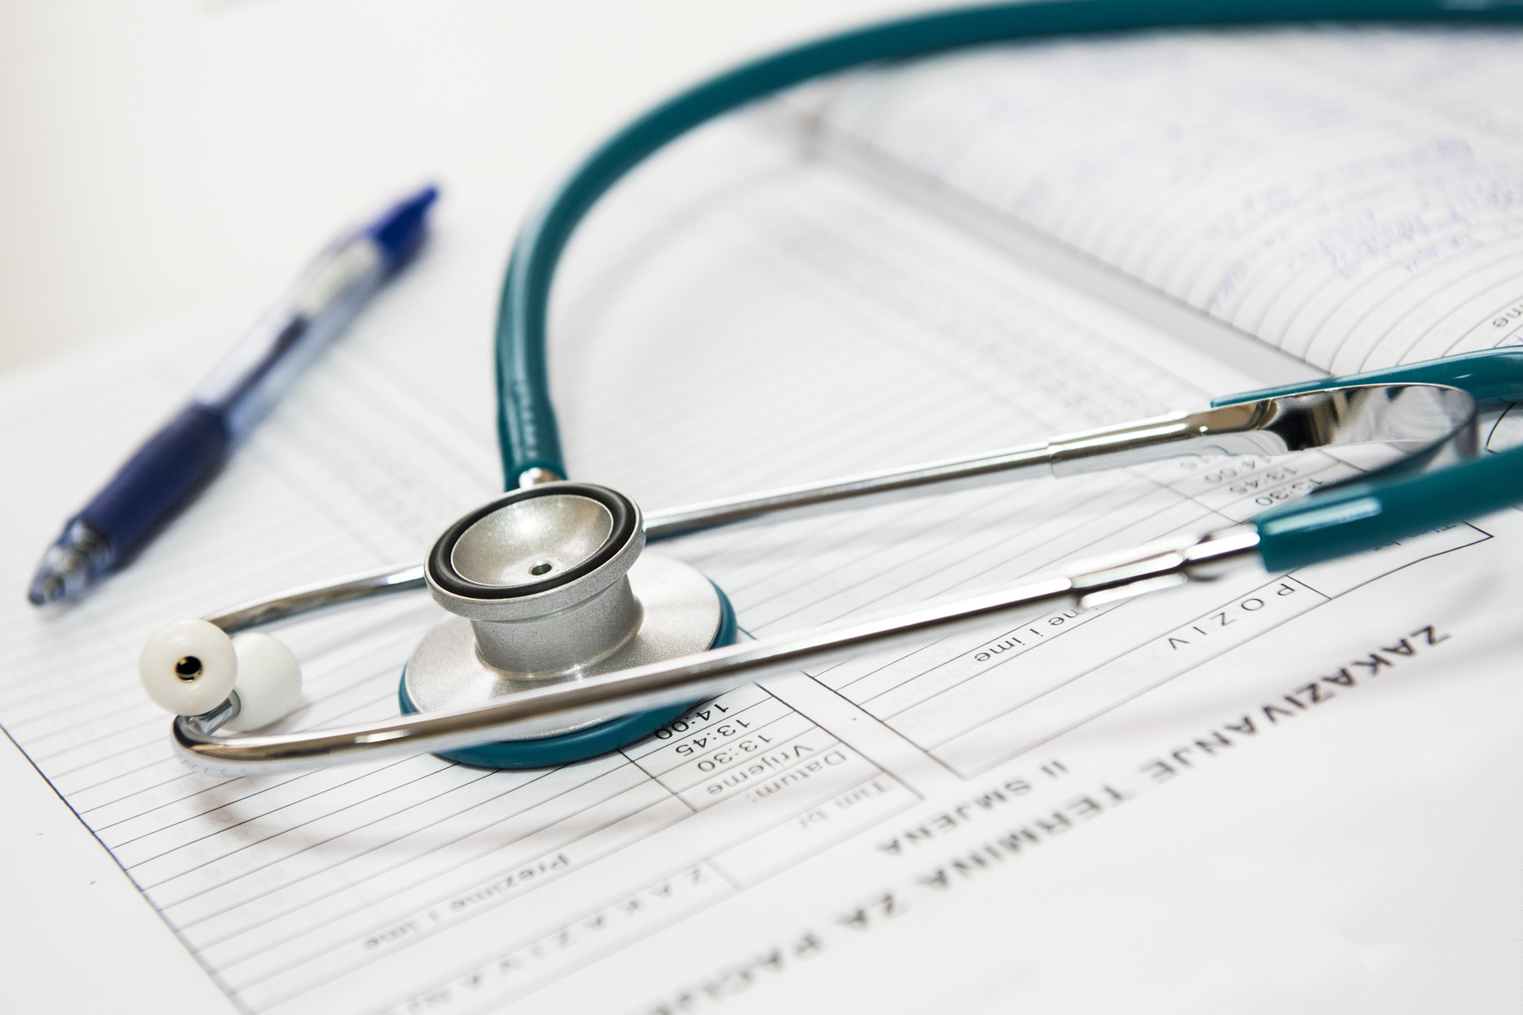
Problem Statement
Hospital logistics, responsible for acquiring, receiving, and stocking, constitutes a substantial 46% of total hospital expenditures, presenting financial challenges amidst economic restrictions.
During medical emergencies or outbreaks, hospitals consistently confront shortages of vital components or equipment, underscoring the critical role of efficient healthcare logistics.
The transfer of medical equipment from manufacturers to hospitals, known as healthcare logistics and management, demands a robust and comprehensive mechanism to guarantee swift delivery during urgent situations.
Team PRM
Presented By : Larana Corporate

Slide 3
Goals
Timely Resource Delivery to Hospitals:
Establishing a Hospital Communication Network:
Mitigating Global Resource Shortages:
Streamlining Supply Chains:
Ensure efficient and timely delivery of essential resources to hospitals.
Minimize disruptions to the hospital’s day-to-day operations while meeting their critical needs.
Identify and eliminate current blockages in the supply chain of pharmaceutical and medical equipment manufacturing industries.
Enhance the overall efficiency and reliability of the supply chain to meet the demands of healthcare institutions promptly.
Create a network of hospitals for effective communication during global shortages of resources.
Facilitate collaborative efforts among hospitals to share information, resources, and best practices.
Develop strategies to mitigate the impact of global shortages on hospitals.
Implement measures that leverage the hospital communication network to optimize resource allocation and minimize the effects of scarcity.
Team PRM
Presented By : Larana Corporate

Slide 4
- Create a centralized platform for direct communication between health providers and legal drug producers/distributors, enhancing transparency and efficiency in healthcare logistics.
- Establish a platform enabling hospitals to swiftly and accurately request medical equipment from others in stock, fostering collaborative resource sharing during urgent situations.
- Implement robust inventory tracking for hospitals to effectively manage stock, forecast future needs, and strategically place orders with manufacturers.
- Integrate the platform with the global hospital communication network for seamless information exchange during global shortages, optimizing resource allocation.
- Develop strategies within the platform for efficient resource allocation during shortages, leveraging the interconnected hospital network.
- Facilitate the replacement of crucial equipment by hospitals, reducing the impact of shortages and ensuring the continuous availability of essential medical resources.
Team PRM
Presented By : Larana Corporate

Slide 5
Key Features
Enhance Pharmacy stock management in Hospitals for improved demand tracking
Enhance Pharmacy Stock management for improved tracking demands
Facilitate sourcing by providing comprehensive inventory tracking information to streamline operations.
Transmit inventory-related details, including required quantities, to vendors for effective planning.
Engage doctors in the equipment purchase process to ensure their involvement and expertise.
Task pharmacists with monitoring all prescribed medications, assessing demand, and maintaining optimal stock levels for each drug.
Recognize the pivotal role of transportation in healthcare, ensuring timely delivery of crucial medical equipment.
Team PRM

Slide 6

Benefits
Timely resource allocation, reducing the impact of shortages during emergencies.
Cost optimization through efficient logistics and supply chain management.
Improved collaboration among hospitals, fostering information and resource sharing.
Enhanced stock management, allowing better forecasting and reducing the risk of shortages.
Data-driven decision-making with comprehensive tracking of inventory, demand, and stock levels.
Optimized equipment purchase by involving doctors in the decision-making process.
Increased visibility into the global status of resources through integration with a communication network.
A patient-centric approach with streamlined processes for timely and effective care.
Efficient medication management by pharmacists, preventing shortages and ensuring patients receive necessary treatment.
Reliable transportation, ensuring the timely delivery of critical medical equipment.
Team PRM
Presented By : Larana Corporate

Slide 7
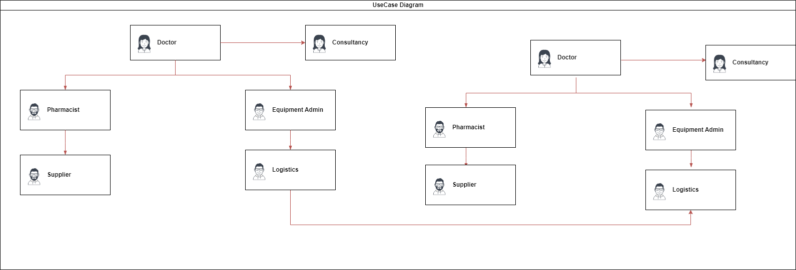
Use Case Diagram

Slide 8
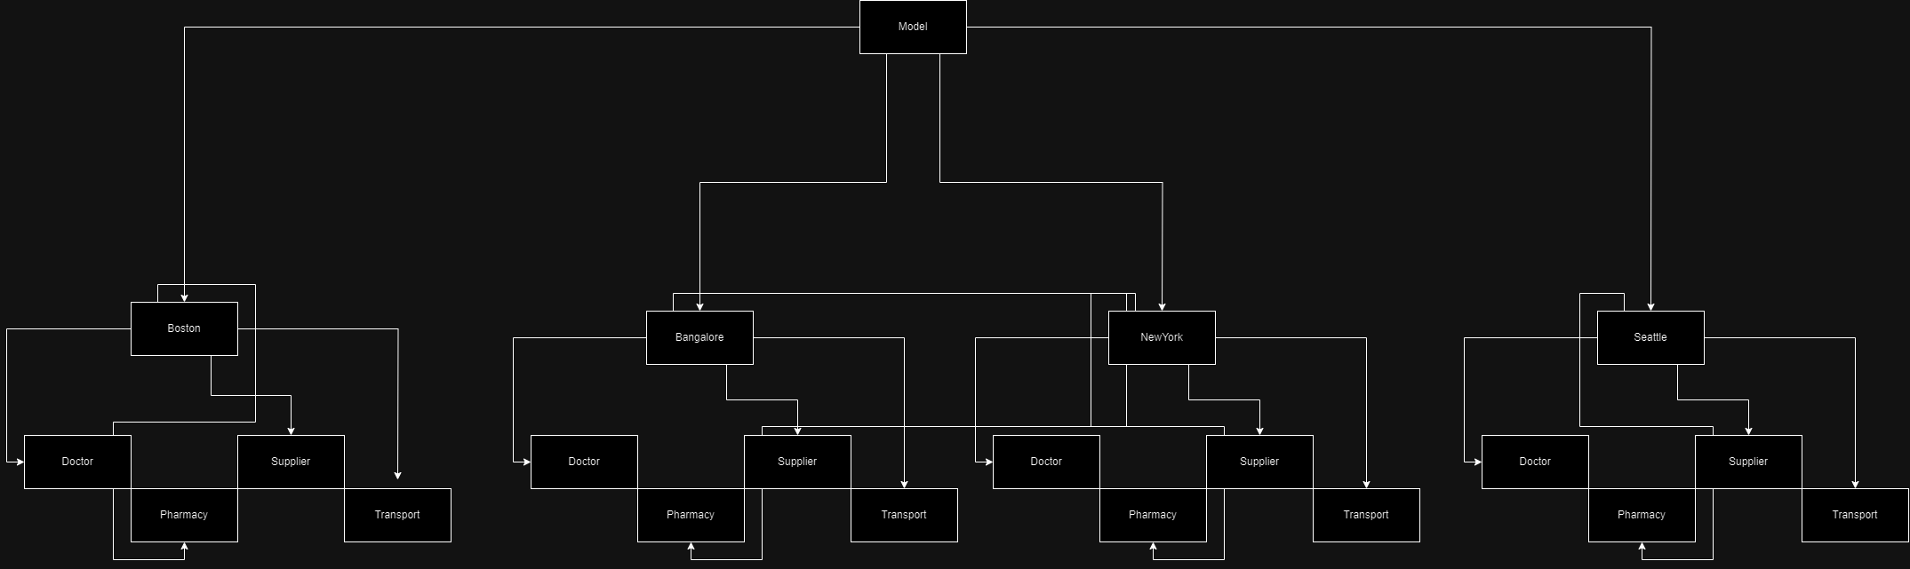
Flow Diagram

Slide 9
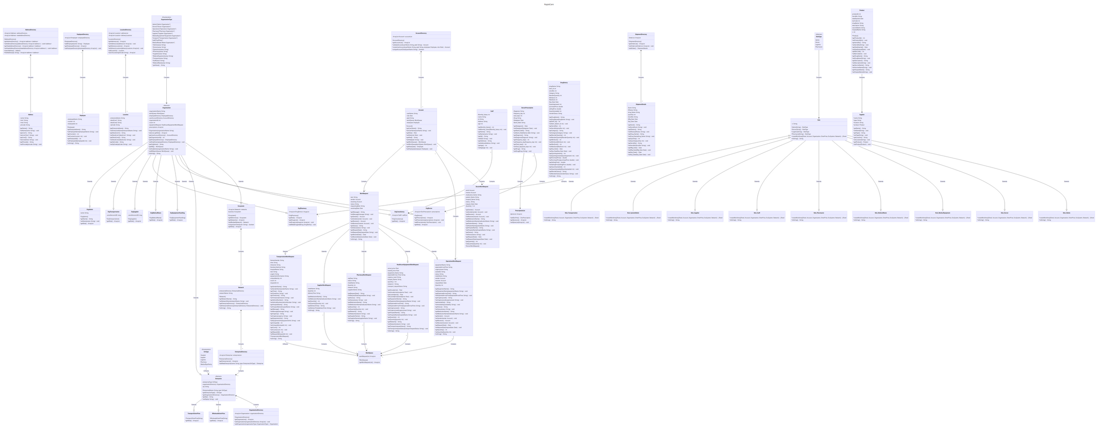
UML Diagram

Slide 10
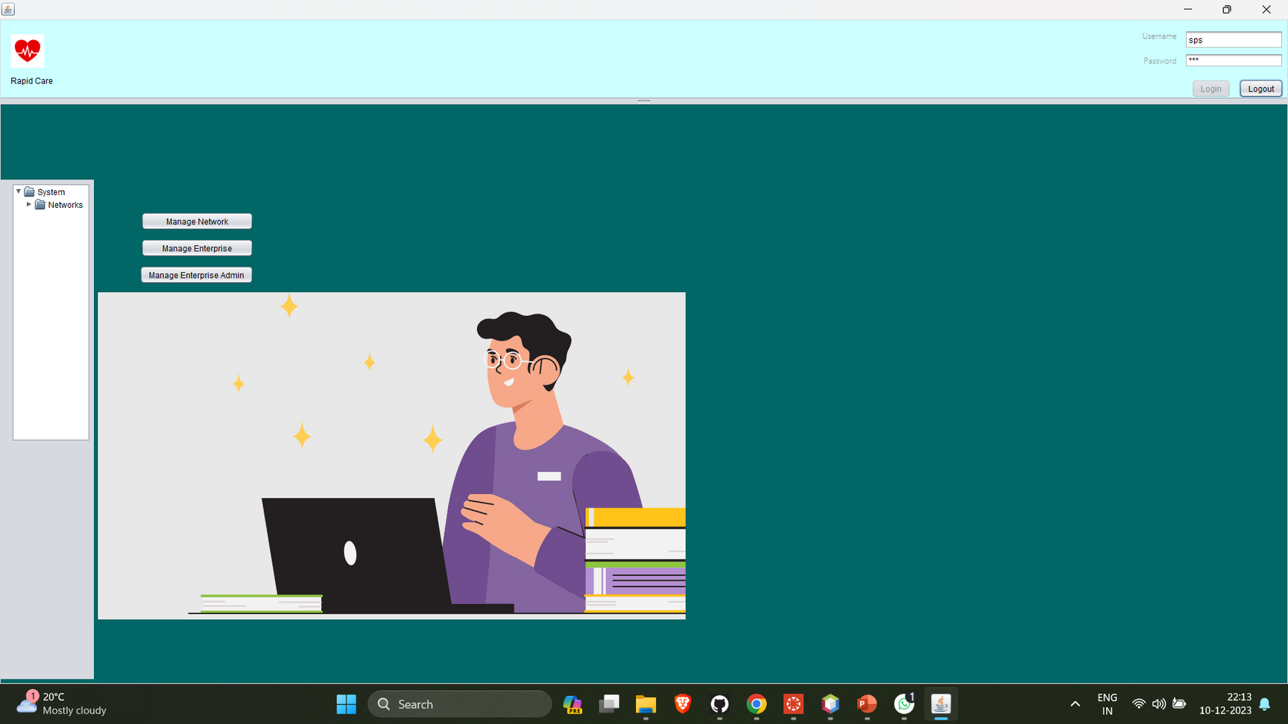

Slide 11
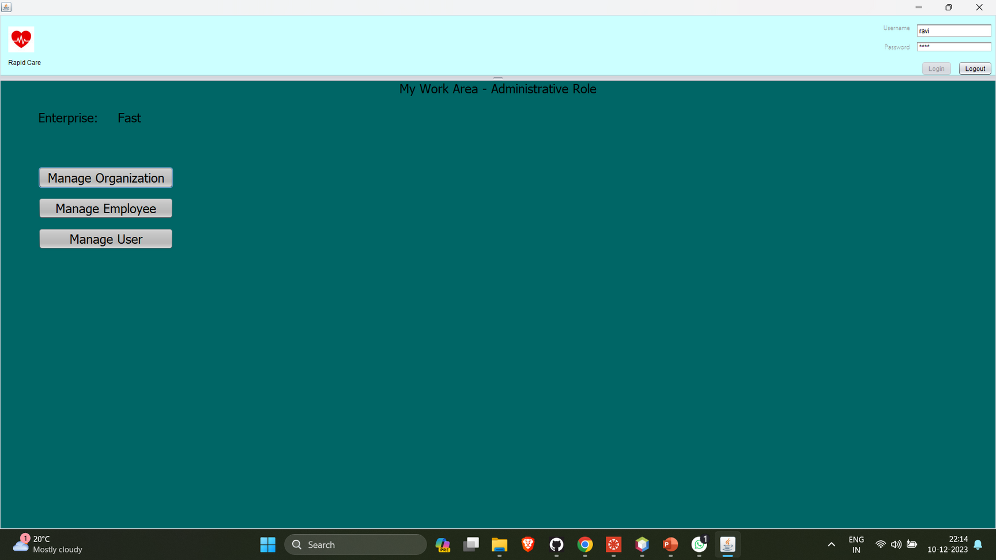

Slide 12
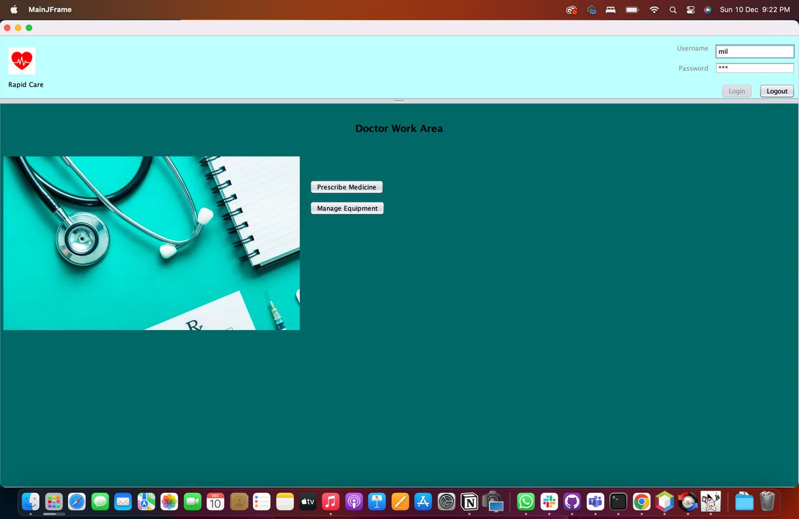

Slide 13
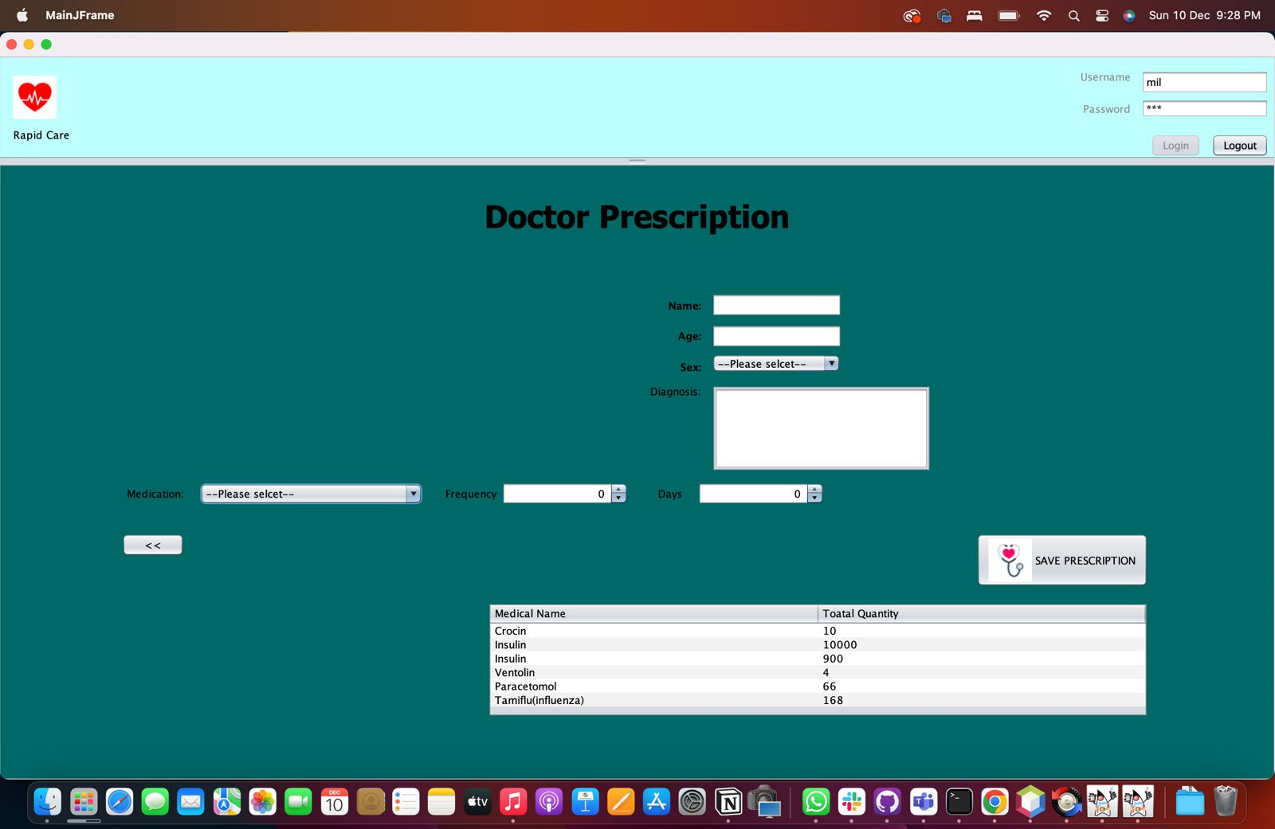

Slide 14
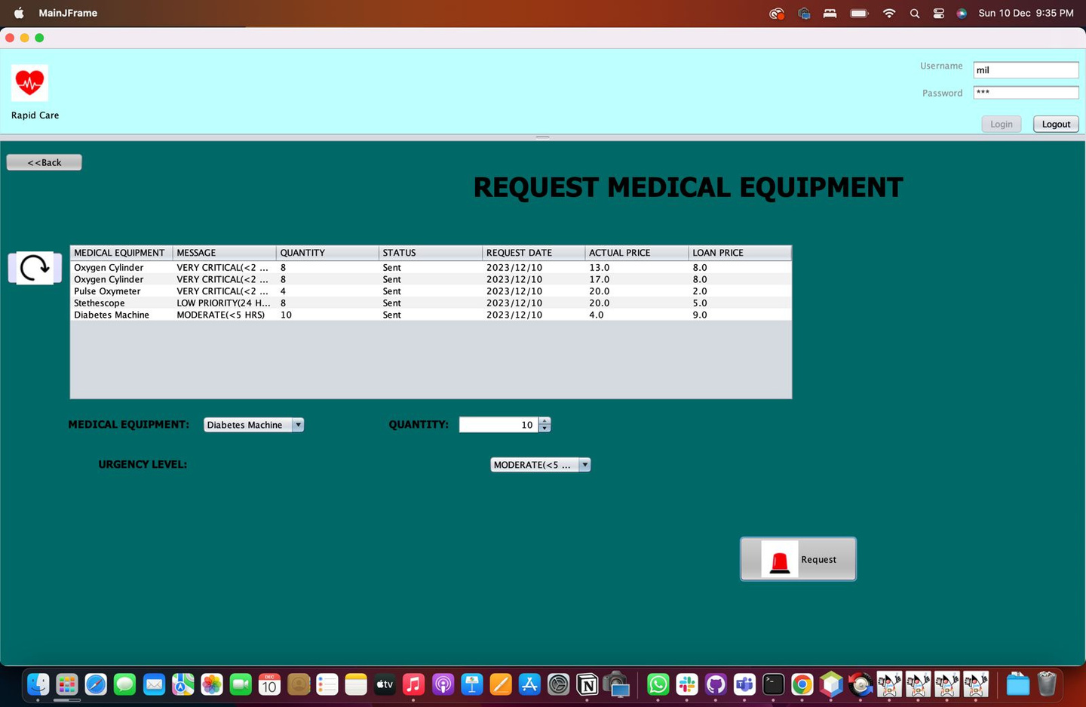

Slide 15
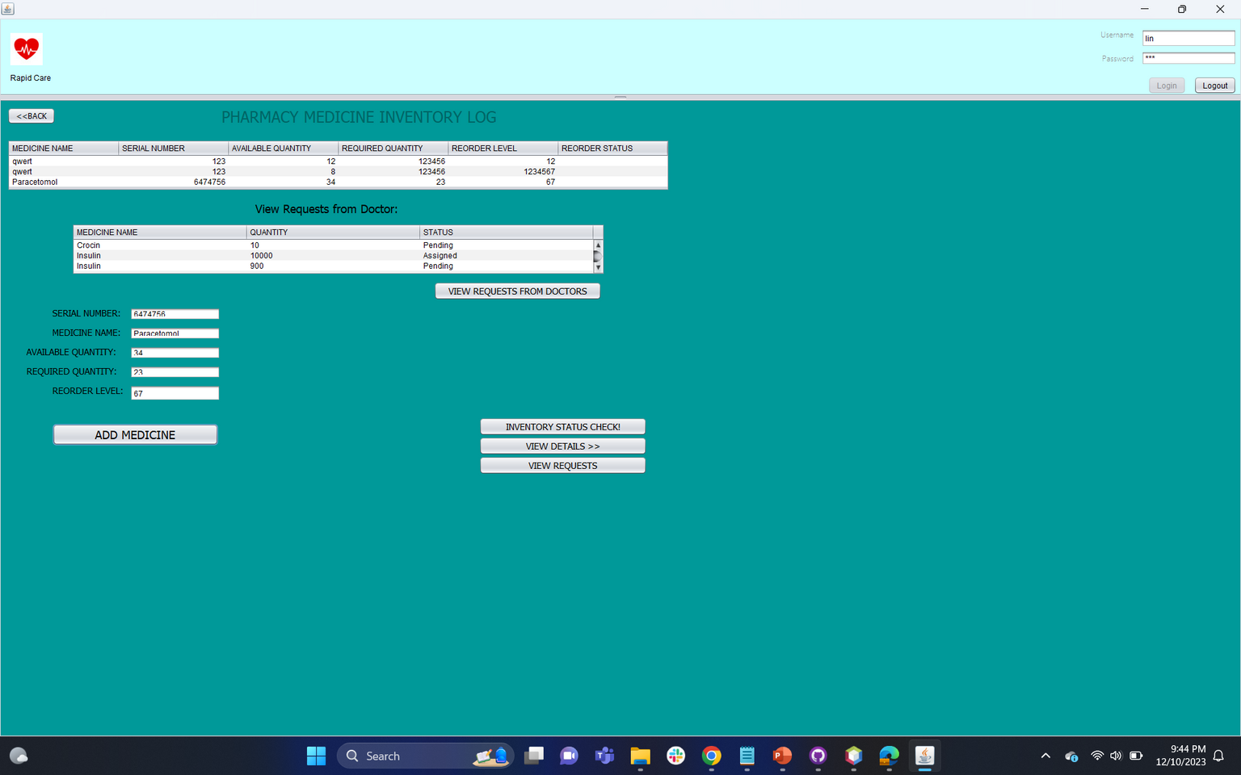

Slide 16
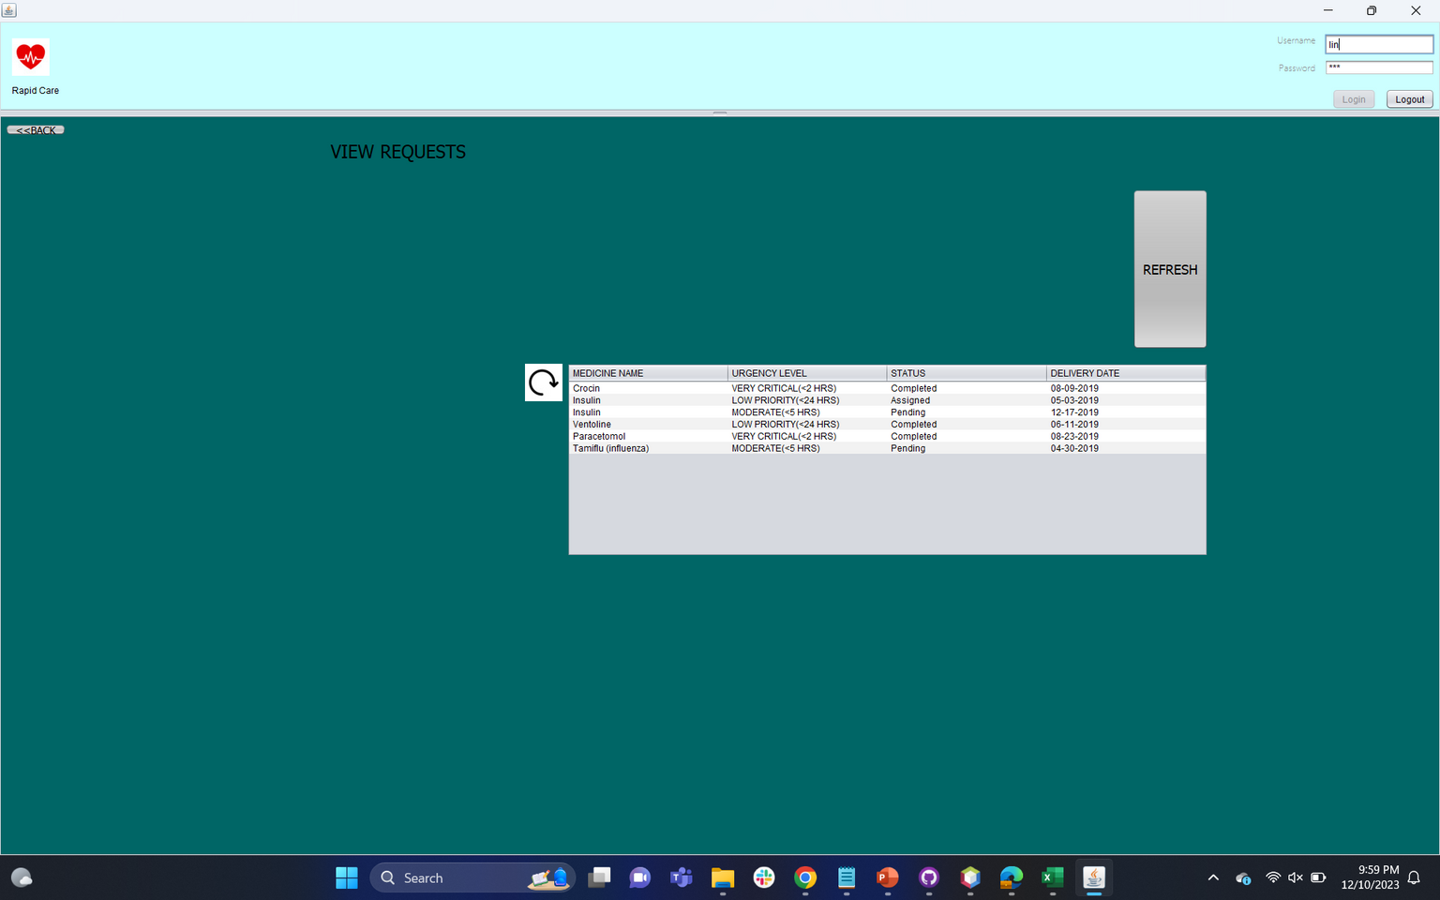

Slide 17
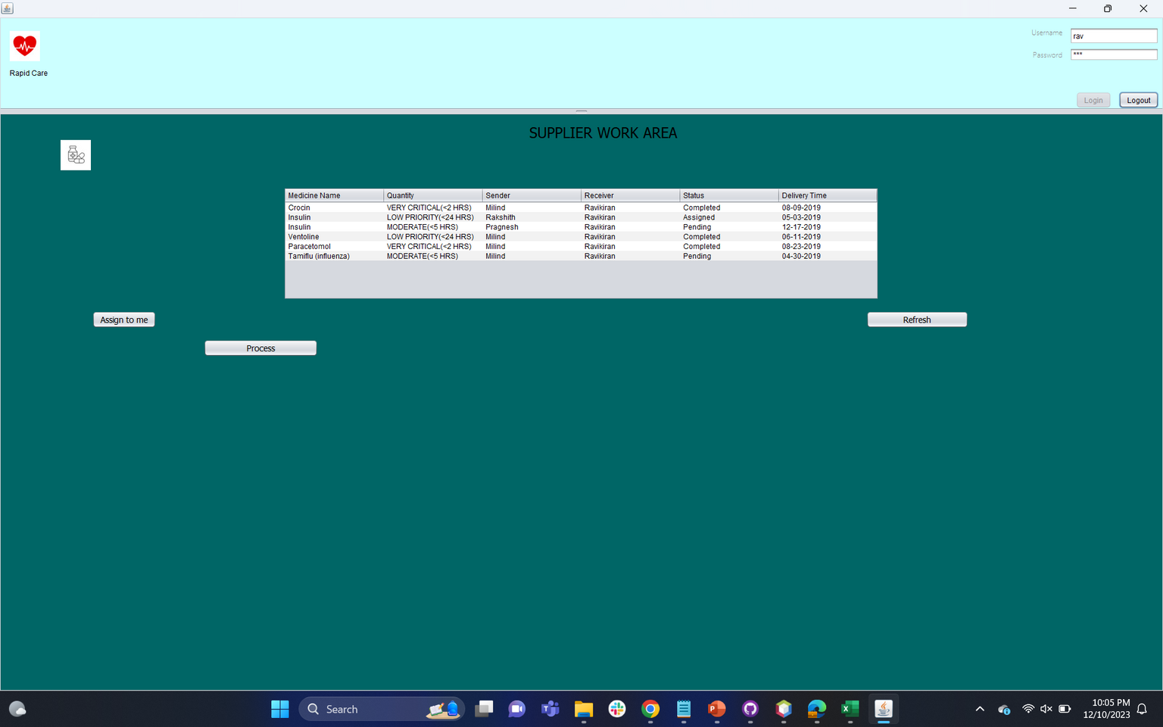

Slide 18
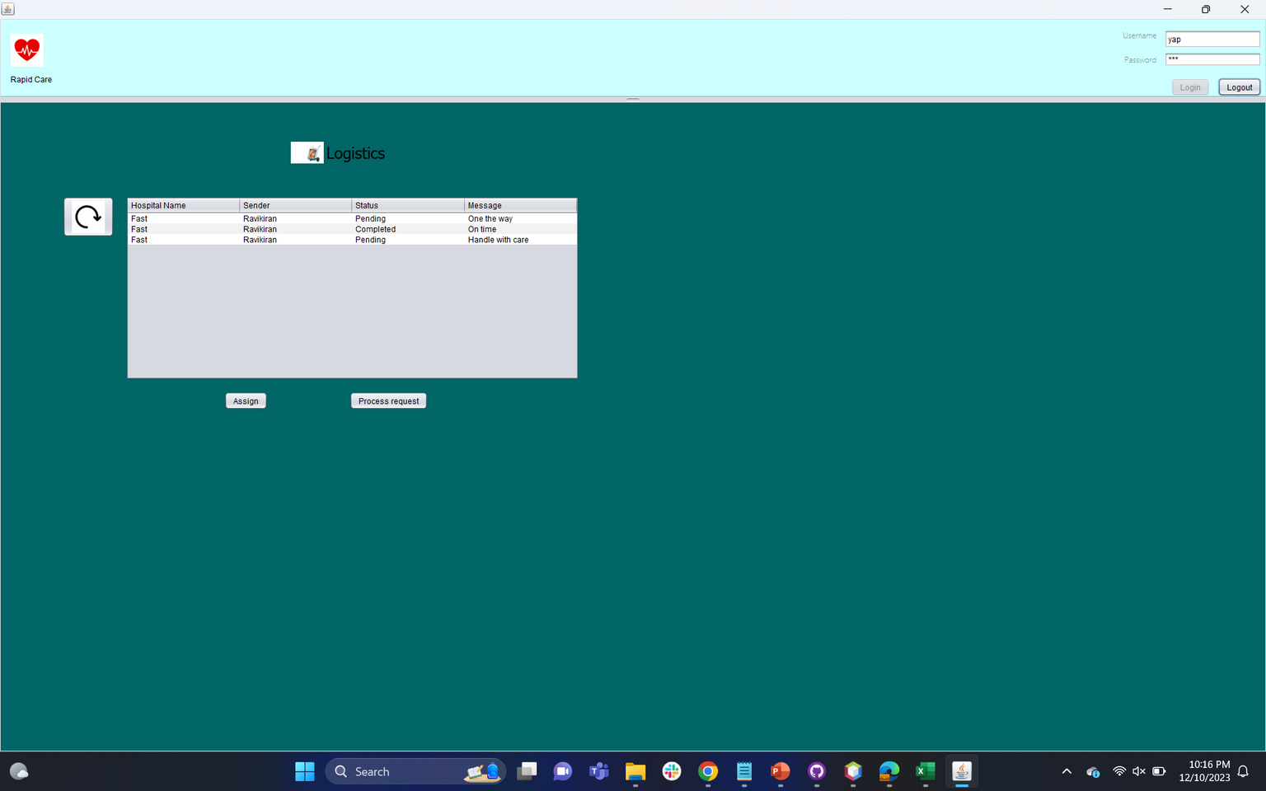

Slide 19



The Team
Milindh Kashyap
Rakshith Rajkumar
Pragnesh Anekal
Member
Member
Member

